Slide 1
Activities and Layouts
CMP SCI 4020/5020
Spring 2019

Slide 2
Layouts
Define the visual structure of the UI
Can be created using XML and/or directly in code (runtime)
In MVC, this is entirely or part of your “V”
Using XML - quite a few pre-defined “widgets” and layouts (pretty flexible already)
Need to have the XML namespace to include the Android XML elements/vocabulary (usually already set)

Slide 3
Common Layouts
(ViewGroup)
ViewGroup - A widget that contains and arranges other widgets
Linear Layout - Organizes child elements in a single vertical or horizontal row
Creates a scrollbar if the window exceeds the screen
Relative Layout - Child elements are “relative” to each other or the parent element
Uses specific attributes to describe relativity
Frame Layout - Everything is displayed in a single frame
Widgets get stacked on top of each other/overlap
You use attributes to set their position within the frame

Slide 4
Common Layouts
(ViewGroup)
TableLayout - Arranges child elements in rows and columns (columns start at 0 not 1)
Uses TableRow layouts to define each row
TableRow set to span XX columns
Really more like one column with a linear layout..
GridLayout - Layout is chopped into a grid
Similar to a TableLayout in a way but has automatic index selection
Does not use a TableRow and any Widget can be used

Slide 5
Common Layouts
(ViewGroup)
Constraint Layout - Layout uses “constraints” to tie together the entire interface
Layout is somewhat similar to Relative Layout
Must have certain constraints satisfied to layout one item
Relatively new in Android (iOS has had this for some time now so could be beneficial to learn)

Slide 6
Layout Attributes
There are a TON of these
They are specific to the widget but share a lot of common attributes
layout_width, layout_height - Required for most all types
match_parent - The widget will match the size of its immediate parent element (width or height)
wrap_content - Widget will only be the size that its content will need
You can also specify a “dp” value (dp is density pixels. We will use these for dynamic screen sizing)
You may sometimes see a “0dp” added in automatically. This is fine and can be left alone

Slide 7
Attributes
Orientation - Vertical or horizontal
Determines how the layout will populate its children (LinearLayout for example)
layout_margin, padding - Same as CSS margin and padding using “dp” (“em” is also acceptable but we most likely will not use)
gravity - Where you want the child element to “stick to”
Set on the parent element. Things like TextView have different attributes to set text in the center of its own container

Slide 8
Android ID
android:id - A unique identifier for the element
Set on EVERY view that needs to be referenced in code
This is the reference that you will need to access in code
Try not to reuse the same id in this (you can but it could cause some headaches later)
set by - android:id=“@+id/named_identifier” This is different than most other assignments
Cannot have spaces, common practice is underscores

Slide 9
Android Strings
Can be added directly but the IDE will complain so…
we store them in the values/strings.xml file
Accessed by its “name” attribute
the XML Value is returned
Use case - android:text=“@string/referenced_name” In strings.xml - <string name=“referenced_name”>Hello, world!</string> This widget would display “Hello, world!”
This should be how you define and access all strings APP WIDE
Strings can also be referenced in code just like android:id can be: textView.setText(R.strings.referenced_name);

Slide 10
Strings.xml
Special characters must be escaped: <string name=“…”>David\’s \”wonderful\” android tutorial</string>
Strings can also have placeholders in them: <string name=“…”>There are %d items.</string> <string name=“…”>My name is %s!</string> <string name=“…”>Your total is %0.2f</string>
You can even do multiple string placeholders: <string name=“…”>Hello %1$s, you received a call from %2$s.</string>

Slide 11
Strings
<string name=“…”>Hello %1$s, you received a call from %2$s.</string> == %1 is the first index and %2 is the second. $s represents a string will be in that place $.2f would represent what then?
How do you use more than one then: textView.setText(R.string.string_id, stringTextOne, stringTextTwo);

Slide 12
Accessing The View from an Activity
Done in the “onCreate” method
setContentView(R.layout.layout_name);
This links the activities “view” to the layout
This does NOT link the respective items yet

Slide 13
Accessing Elements in an Activity
Must be done after setContentView( R.layout.layout_xml );
Activity has a findViewById( ) method
myTextView = (TextView) findViewById(R.id.textviewId_in_layout); You must Cast the view to the type.
You are now wired up to the interface layout_xml.xml
This needs to be done for every “View” or Widget in the layout file that you need to access
We will use a different way of finding views as this is expensive

Slide 14
Android Activity
"A single, focused thing that the user can do."
Takes care of creating the window that your UI layouts populate into
Activities can use the entire window or be contained within another activity
This is the “C” of your MVC
Controllers (Activities) typically hold on to your views
As a result, it contains view lifecycle methods

Slide 15
Android Activity
In order to get the context, an activity MUST be added to the manifest file
Failure to do so will result in a runtime exception (aka the app will crash)
Is the base for using Fragments (will cover this later)
7 methods that maintain the activity lifecycle

Slide 16
Activity Lifecycle
onCreate( )
onStart( )
onResume( )
onPause( )
onStop( )
onRestart( )
onDestroy( )

Slide 17
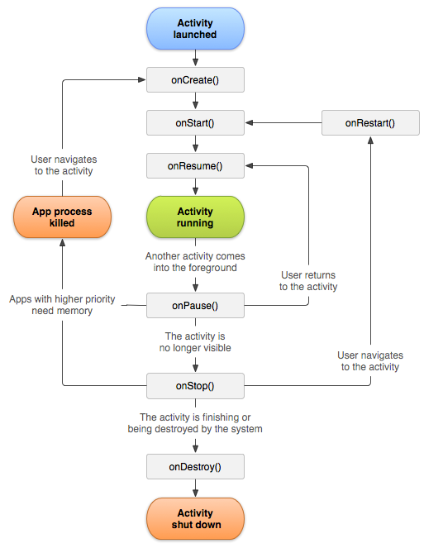

Slide 18
View/Activity Lifetimes
Entire Lifetime - happens between onCreate( ) and onDestroy( )
The moment the activity is created to when it is destroyed
Visible Lifetime - happens between onStart( ) and onStop( )
Activity is onscreen but may not have focus
Where you would normally manage the UI re/construction
Foreground Lifetime - happens between onResume( ) and onPause( )
Activity is front and center

Slide 19
Configuration Changes
If the layout is changed based on the configuration of the device, the activity will be destroyed
will traverse through onPause( ), onStop( ), and onDestroy( )
When is a case that this would happen? (hint: this happens a lot..)

Slide 20
Configuration Changes
Most common configuration change is screen orientation…..what?? why??
This is because any layout resource can be changed on an orientation change
Have to store current settings, selections, entered text, etc. to a Bundle
But how?

Slide 21
With a Bundle
This is ONLY meant for configuration changes
Only small data sets such as repopulating a selected/available state (not images or large data sets)
onSaveInstanceState(outState: Bundle) to save content
check the savedInstanceState to restore content: fun onCreate(savedInstanceState: Bundle) { savedInstanceState?.let { … } }
There is something else as well

Slide 22
ViewModel (new)
Used to store and manage UI related data
Pays close attention to the lifecycle
Will actually survive a configuration change!
You have no idea how fantastic this is yet...
Accessed via a ViewModelProvider
Can use "LiveData" class to observe changes to update UI
https://developer.android.com/topic/libraries/architecture/viewmodel

Slide 23
Enough of this for now
Let’s see some Kotlin

